Slide 1


Some guidelines..
Video/Audio lagging – Go ahead and “Troubleshoot” : Leave, clear cache & re-join
Remember: When in doubt, reach out : support@edureka.co
If you feel like calling, give us a ring: USA : 1 877 959 4010 (Toll Free) | INDIA : +91 80474 74500
Muted by default & Unmuted in the end for any advanced queries
Let’s be interactive: Question box (Doubt intervals – 15 minutes) & Hand Raise ( for change of pace)

Slide 2
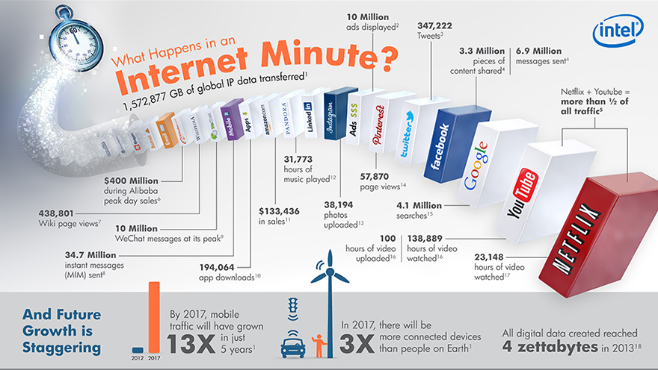
Big Data World

Slide 3

Scaling Out Horizontally
Scaling “out” to bigger clusters of commodity-priced systems has almost a linear cost curve
Partitioning and Replication

Slide 4
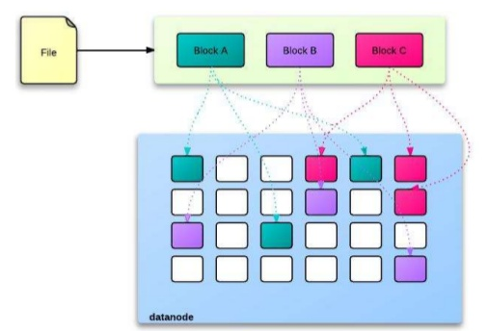
What is Hadoop
The business value of Hadoop is this: Hadoop solves the low-level problems of scheduling and coordinating work in a shared-nothing computer cluster, sends work to the nodes where data is stored so that it can be processed most efficiently, and detects and recovers from partial failure in the cluster.
Hadoop solves these fundamental problems for parallel processing. You can focus on writing a small program to analyze data, and Hadoop will make sure the program is executed by the cluster.
Google published a white paper on MapReduce framework (2004)
Doug Cutting & Mike Cafarella made Hadoop (2005)
It is NOT Big Data, neither is it a database
Platform (framework)
Core Hadoop Components
Hadoop Distributed File System (HDFS)
Distributed Computing Engine (MapReduce)
Cluster Manager (YARN)

Slide 5
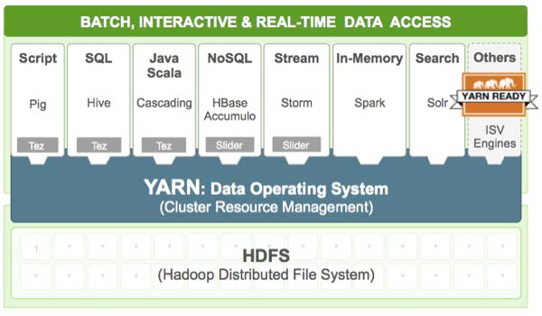
Hadoop Ecosystem
HDFS = Hadoop Distributed Filesystem: A file system for storing big datasets on a cluster; it makes the cluster look like it’s just one big disk. Behind the scenes, it replicates the data and protects against node failure.
MapReduce: a programming framework for parallel processing of data. The user defines two programs – a “mapper” and a “reducer” – and Hadoop coordinates execution throughout the cluster
YARN and the rest of the ecosystem: YARN is the resource manager and scheduler in newer versions of Hadoop, and it allows other applications besides MapReduce to be executed within a Hadoop cluster. This has led to a proliferation of new Hadoop-based systems like Pig, Hive, HBase, and Spark

Slide 6


Spark
(2007 – 2015?)
Giraph
Pregel
(2012– ?)
(2004 – 2013)
Tez
Drill
Dremel
Mahout
Storm
S4
Impala
GraphLab
General Unified Engine
General Batch Processing
Specialized Systems
(iterative, interactive, ML, streaming, graph, SQL, etc)

Slide 7







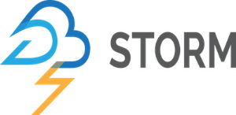
vs
YARN
YARN
SQL
MLlib
Streaming

Slide 8
